Slide 1
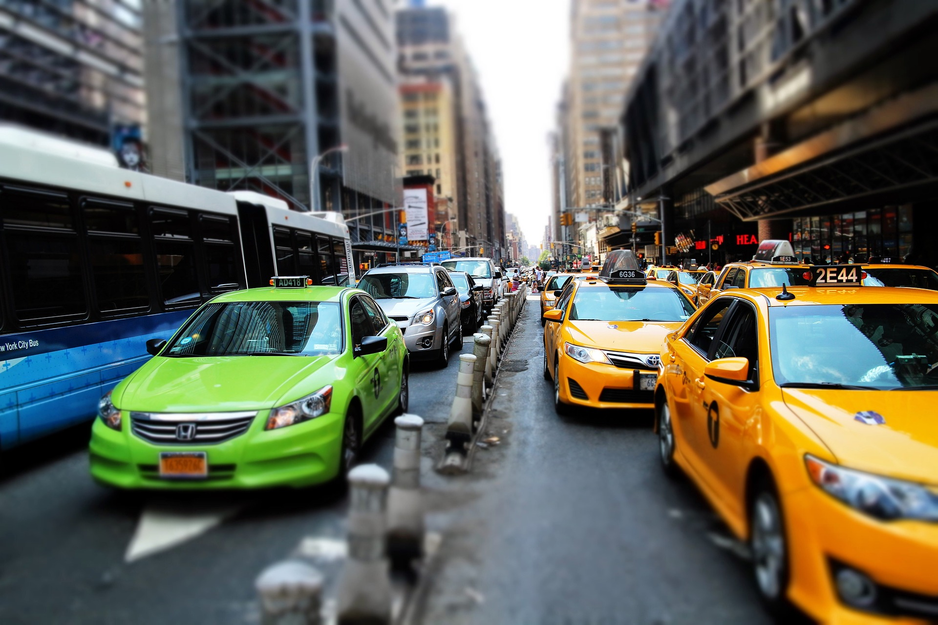
Making NYC Roads Safer
AN IN-DEPTH ANALYSIS INTO MOTOR VEHICLE COLLISIONS FROM 2012-2022
A Presentation
by Orville Pagaduan
Notes:
Ladies and gentlemen, esteemed members of our community, and distinguished guests,
I am honored to stand before you today to delve into a critical topic that affects each and every one of us – the safety of our roads in the bustling metropolis of New York City. Over the next few moments, we will embark on a journey of analysis, discovery, and understanding, as we explore a decade's worth of data concerning motor vehicle collisions within the five boroughs of NYC, spanning from 2012 to 2022.
The roads of New York City are the arteries of our daily lives, connecting us to our homes, workplaces, schools, and countless other destinations. They are not just thoroughfares but the lifeblood of our city's existence. Therefore, ensuring their safety is paramount.
In recent years, the issue of road safety has garnered increasing attention as motor vehicle collisions have shown a concerning trend of escalation. In light of these developments, it becomes our collective responsibility to meticulously investigate the factors contributing to these incidents, to understand their patterns, and, most importantly, to advocate for comprehensive strategies aimed at mitigating the risks and making NYC roads safer for all.
Our presentation today will be a journey through data, analysis, and ultimately, recommendations. We aim to provide you with a comprehensive overview of the state of road safety in New York City, not merely as observers but as active participants in creating a safer, more secure urban environment.
Together, we shall explore the data collection methods, identify key trends, analyze high-risk areas, and delve into the contributing factors behind these collisions. I invite you all to engage with an open mind, ask questions, and participate in the dialogue that follows. Road safety is a challenge we must confront collectively, drawing from the expertise and commitment of each individual in this room. By the end of this presentation, we hope to not only raise awareness but also inspire concrete actions to ensure that every New Yorker can navigate our city's streets safely.
Without further ado, let us embark on this journey together, as we take the first step towards making NYC roads safer for all. Thank you for your attention and dedication to this crucial endeavor.

Slide 2
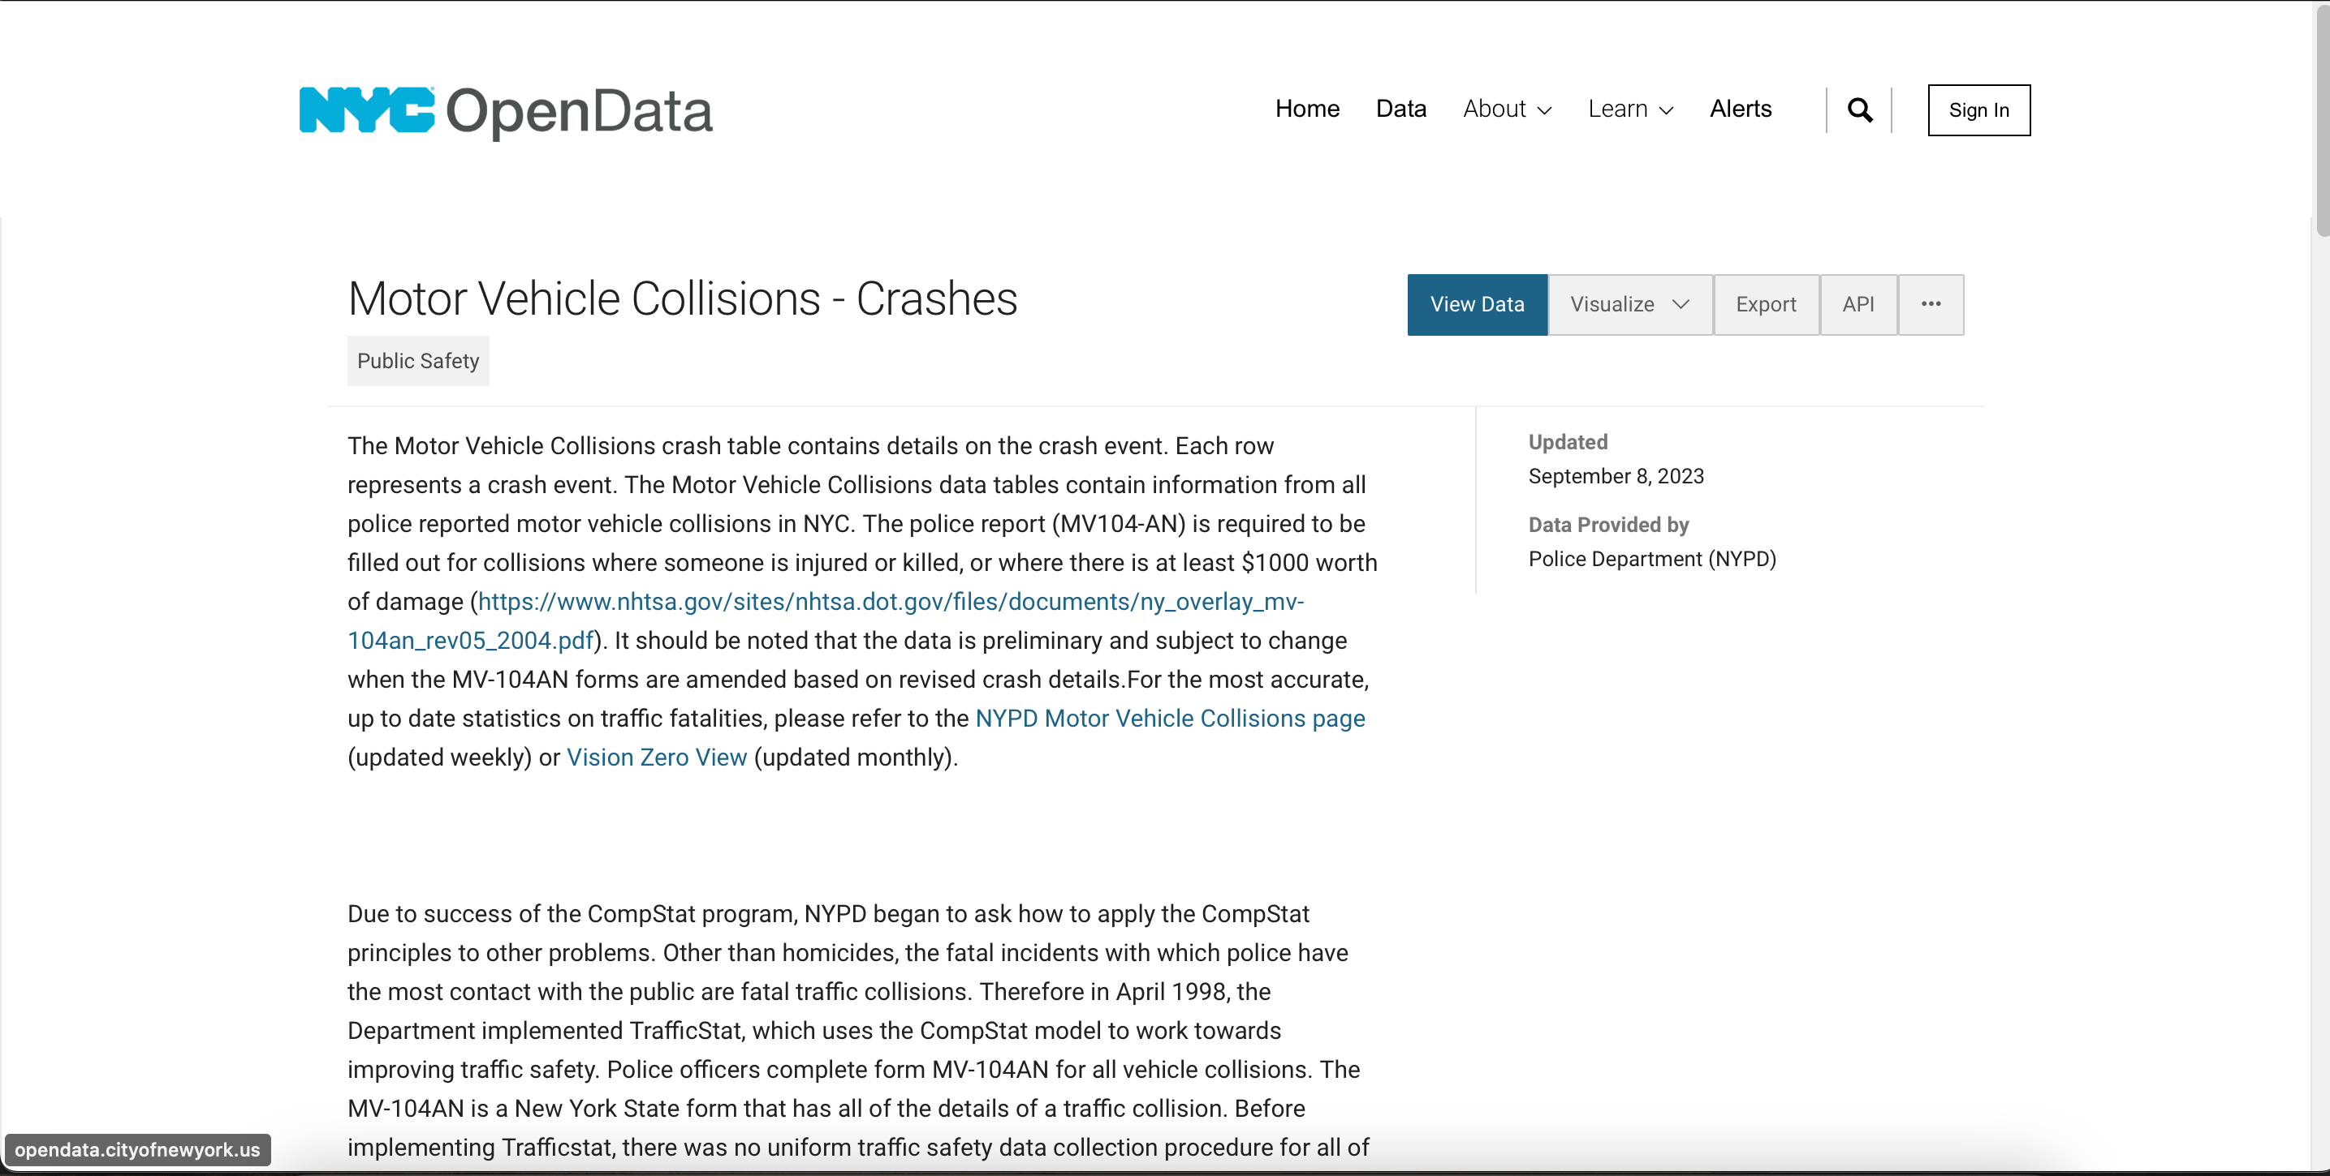
About the Dataset
Notes:
Dataset Source: NYC Open Data - Motor Vehicle Collisions - Crashes
The foundation of our analysis lies in the extensive dataset obtained from NYC Open Data - specifically, the "Motor Vehicle Collisions - Crashes" dataset. This invaluable resource provides a comprehensive understanding of motor vehicle collision events within the five boroughs of New York City.
Dataset Details:
Each row in the dataset represents a unique crash event.
The data encompasses information from all police-reported motor vehicle collisions in NYC.
The dataset relies on the completion of the official police report form known as "MV104-AN," which is mandatory for collisions resulting in injuries, fatalities, or property damage exceeding $1000.
Data Quality and Updates:
It's important to note that the data is considered preliminary and may be subject to change. This can occur when the "MV-104AN" forms are updated to reflect revised crash details.
For the most accurate and up-to-date statistics on traffic fatalities, we recommend referring to the NYPD Motor Vehicle Collisions page, which is updated on a weekly basis. Additionally, Vision Zero View provides monthly updates on relevant data.
This dataset forms the cornerstone of our analysis, enabling us to identify trends, patterns, and contributing factors in motor vehicle collisions over the past decade. The quality and accuracy of this data are crucial in our mission to make NYC roads safer.
As we progress through this presentation, we will delve deeper into the insights and knowledge that this dataset offers, allowing us to make informed recommendations and work collectively toward a safer urban environment.

Slide 3
Approach
THE PROBLEM -Have a good understanding of the problem statement - "How to reduce deaths and accidents in Brooklyn" based on 2012 - 2022 data.
PREP THE DATA - Got clarity of dataset, performed data cleaning (Duplicate entries, Null Values etc.) and exploratory data analysis using SQL queries
DEEP DIVE - Prepped data & analyzed top collision causes. Carried out time series analysis & fatality analysis on different categories of road users
INSIGHTS - Results were presented in a dashboard using PowerBI to allow stakeholders interact with the data and get more insights .
RECOMMENDATIONS - Provided recommendations based on insights obtained from the deep-dive for implementation.
Notes:
Understanding the Problem Statement:
Our primary goal is to address the critical issue of reducing deaths and accidents in Brooklyn.
We will base our approach on data spanning from 2012 to 2022, which provides a comprehensive view of motor vehicle collisions in this borough.
Step 1: Data Preparation
Achieving a clear understanding of our dataset is our initial focus.
We have diligently performed data cleaning, eliminating duplicate entries, and addressing null values to ensure the dataset's reliability.
Utilizing SQL queries, we have conducted exploratory data analysis, unearthing valuable insights hidden within the data.
Step 2: Deep Dive into the Data
With a well-prepped dataset, our next step was to delve deeper.
We specifically analyzed the top causes of collisions to identify key trends and contributing factors.
Carrying out a time series analysis allowed us to uncover patterns and changes over the past decade.
Fatality analysis was performed on different categories of road users, shedding light on high-risk groups.
Step 3: Presentation of Insights
The results of our in-depth analysis were meticulously presented through an interactive dashboard created using PowerBI.
This interactive dashboard allows stakeholders to explore the data, gain deeper insights, and make informed decisions.
Step 4: Recommendations for Implementation
Building on the insights derived from our deep-dive analysis, we have formulated concrete recommendations.
These recommendations are tailored to address specific issues identified in our analysis.
They serve as a roadmap for effective interventions and improvements aimed at reducing accidents and fatalities in Brooklyn.
Our comprehensive approach combines data-driven insights with actionable recommendations, all geared towards our shared goal of making Brooklyn's roads safer. As we proceed, we will delve into the specifics of our analysis, insights, and recommendations, working together to create a safer and more secure environment for the residents of this borough.

Slide 4


Tools Used
QUERIES
VISUALIZATIONS
Notes:
Our journey toward understanding and addressing the critical issue of reducing deaths and accidents in Brooklyn from 2012 to 2022 has been empowered by the use of advanced data analysis tools. We are grateful for the capabilities provided by:
1. Google BigQuery:
Google BigQuery has played a pivotal role in our data analysis process.
This cloud-based data warehouse allows us to efficiently handle large datasets and perform complex SQL queries.
BigQuery's scalability and speed have enabled us to gain rapid insights from the extensive Motor Vehicle Collisions dataset.
2. Power BI:
Power BI has been our go-to solution for visualizing and presenting our findings.
This robust business intelligence tool facilitates the creation of interactive and insightful dashboards.
Stakeholders can explore the data dynamically, helping us to communicate our results effectively.
These two powerful tools, Google BigQuery and Power BI, have synergized to provide us with a comprehensive approach to data analysis, visualization, and reporting. Their integration has been instrumental in transforming raw data into actionable insights and recommendations.

Slide 5
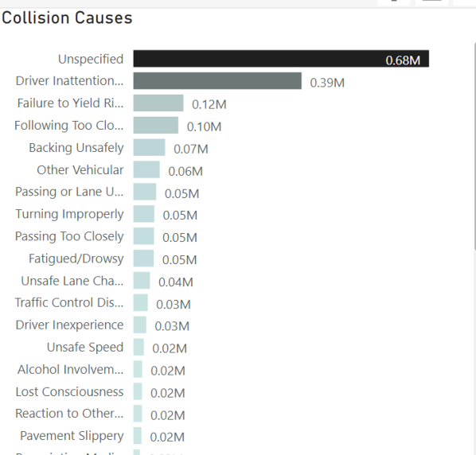
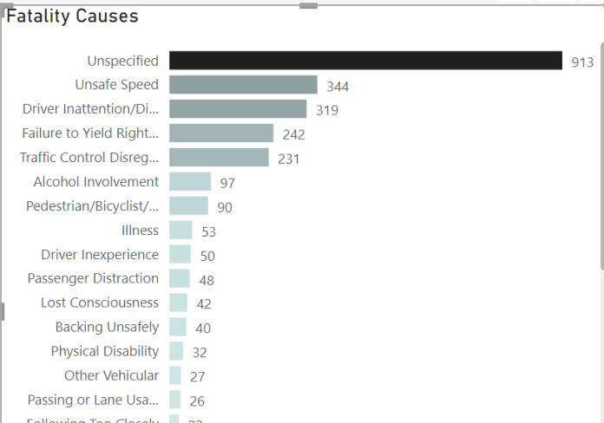
TAKEAWAYS
Top Collision Causes
Top Fatality Causes
Notes:
Our in-depth analysis has unveiled critical takeaways from the data, shedding light on the most significant factors contributing to motor vehicle collisions and fatalities in Brooklyn from 2012 to 2022.
Top Collision Causes:
Distracted Driving: One of the leading causes of collisions in Brooklyn is distracted driving. This includes activities such as texting, phone calls, and in-car distractions.
Speeding: Excessive speeding remains a prevalent issue, contributing significantly to collisions and their severity.
Impaired Driving: Collisions involving impaired drivers, often under the influence of alcohol or drugs, are a significant concern.
Intersection Violations: Failure to obey traffic signals and stop signs at intersections is another common cause of accidents.
Reckless Driving: Aggressive and reckless driving behaviors, including tailgating and sudden lane changes, are contributing factors.
Top Fatalities Causes:
Pedestrian Incidents: Pedestrians are particularly vulnerable, and collisions involving pedestrians represent a substantial portion of fatalities.
Cyclist Incidents: Similar to pedestrians, cyclists face high risks, and accidents involving bicycles can result in severe outcomes.
Impaired Driving: Impaired driving is not only a top collision cause but also a leading factor in fatal accidents.
Intersection Crashes: Collisions at intersections, especially those involving red-light violations, contribute significantly to fatalities.
Single-Vehicle Accidents: Single-vehicle accidents, often associated with speeding and loss of control, result in a disproportionate number of fatalities.
These takeaways emphasize the urgency of addressing these primary causes through targeted interventions and policy changes. By targeting distracted driving, speeding, impaired driving, and improving intersection safety, we can significantly reduce collisions

Slide 6
Recommendations
1. Public Awareness Campaigns
2. Law Enforcement and Accountability
3. Infrastructure Improvements
4. Targeted Education Programs:
5. Ride-Share and Public Transportation Promotion
6. Data Transparency and Continuous Analysis
7. Community Involvement
8. Partnerships and Funding
Notes:
Our analysis has provided valuable insights into the causes of motor vehicle collisions and fatalities in Brooklyn from 2012 to 2022. To address these pressing issues and make Brooklyn's roads safer, we propose the following recommendations:
1. Public Awareness Campaigns:
Launch comprehensive public awareness campaigns targeting distracted driving, impaired driving, and speeding.
Use various media channels, including social media, billboards, and community events, to educate and inform residents about the risks and consequences.
2. Law Enforcement and Accountability:
Strengthen law enforcement efforts to deter reckless driving behaviors.
Increase police presence at high-risk intersections and implement strict penalties for traffic violations.
Utilize traffic cameras and automated enforcement to monitor and enforce traffic laws.
3. Infrastructure Improvements:
Invest in safer road infrastructure, including improved signage, crosswalks, and traffic signals.
Design and implement traffic calming measures, such as speed bumps and pedestrian islands, in high-risk areas.
Enhance bicycle lanes and pedestrian pathways to protect vulnerable road users.
4. Targeted Education Programs:
Collaborate with schools, community organizations, and businesses to implement educational programs.
Focus on teaching safe road behaviors to children and young adults, emphasizing the importance of pedestrian and cyclist safety.
5. Ride-Share and Public Transportation Promotion:
Encourage the use of ride-sharing services and public transportation options to reduce individual car usage.
Promote alternatives that reduce traffic congestion and contribute to a safer road environment.
6. Data Transparency and Continuous Analysis:
Continue to collect and analyze collision data, making it readily accessible to the public and researchers.
Regularly update and refine road safety initiatives based on the latest data and emerging trends.
7. Community Involvement:
Foster community engagement in road safety efforts by forming neighborhood committees.
Encourage residents to report road safety concerns and participate in local initiatives.
8. Partnerships and Funding:
Seek partnerships with government agencies, non-profit organizations, and businesses to secure funding and resources for road safety projects.
Apply for grants and allocate budgets specifically for road safety improvements.
These recommendations are designed to address the root causes of collisions and fatalities, promoting a culture of safety on Brooklyn's roads. By implementing these measures collectively and consistently, we can make significant strides toward reducing accidents and saving lives in our community.

Slide 7
APPENDIX

Slide 8
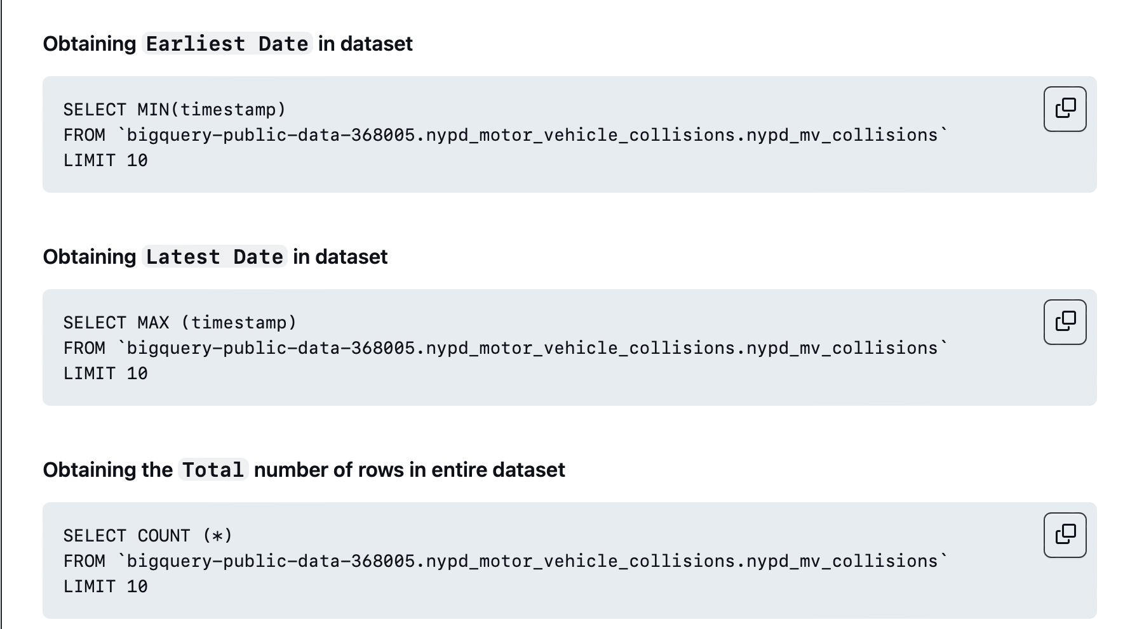
SQL QUERIES

Slide 9
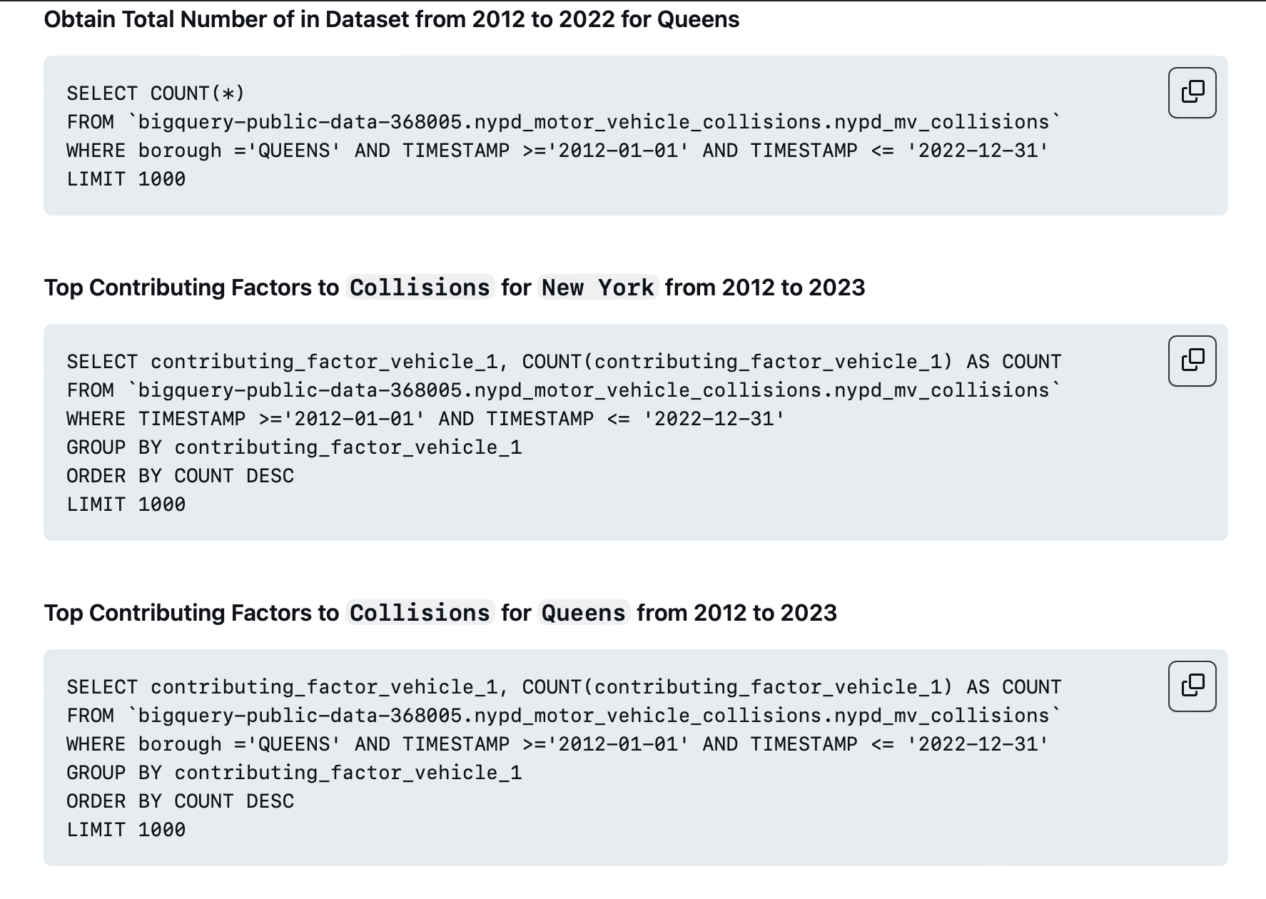
SQL QUERIES

Slide 10
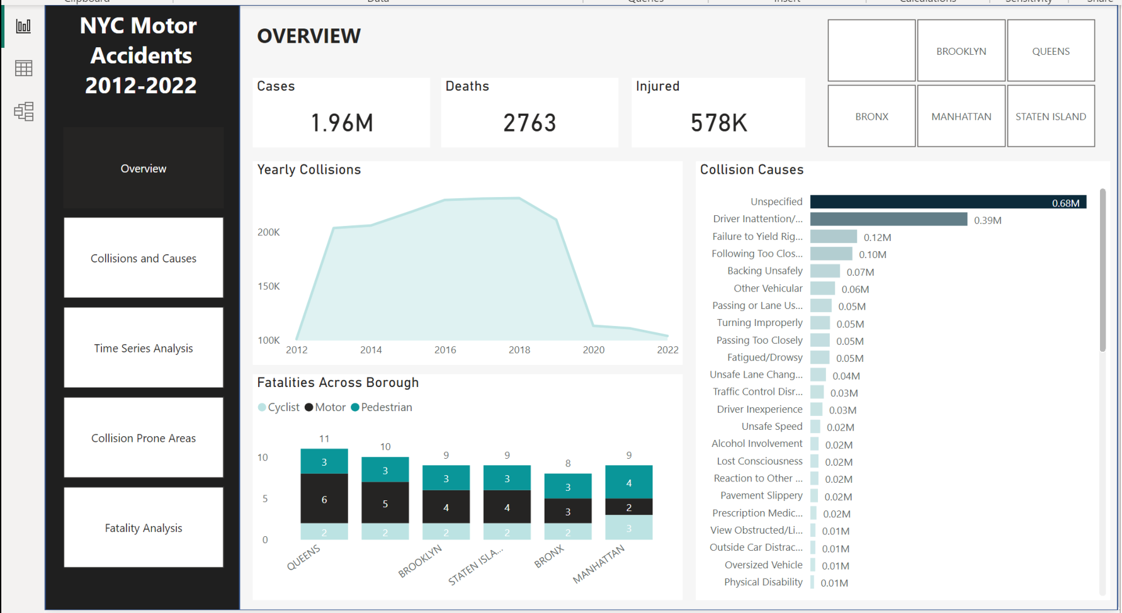
Final Dashboard

